Slide 1
Growing Therapists 101: Psychological Flexibility and Relationship Skills in the Developing Clinician
Emmy LeBleu, Tracy Protti, & Emily Sandoz, Ph.D.
Louisiana Contextual Science Research Group
University of Louisiana at Lafayette

Slide 2
Notes:
becoming therapists or do therapy because we want to change behavior, we feel like we are the context for that, or rather our

Slide 3
Notes:
The therapeutic relationship matters. Arguably one of the most important factors when looking at why a treatment might work, across different psychotherapeutic approaches.
The context is therapeutic interaction or therapy relationship

Slide 4
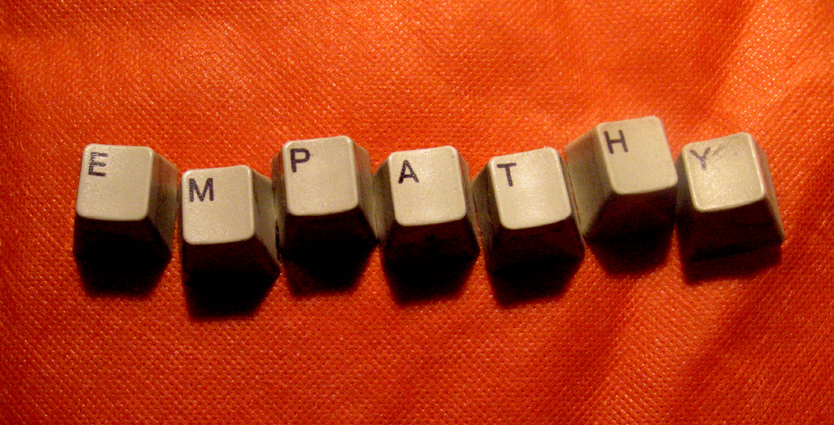
Notes:
Empathy
Perspective taking

Slide 5
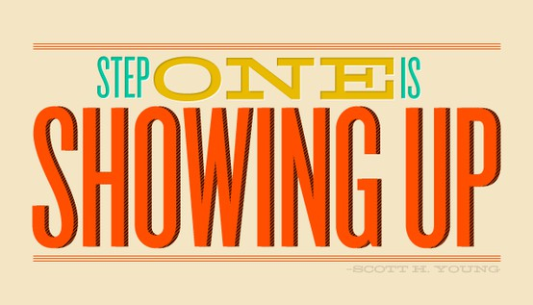
Research for a reason.
Notes:
ACT is no different. The ACT therapist must show up, and connect with the client in order for meaningful change to happen.

Slide 6
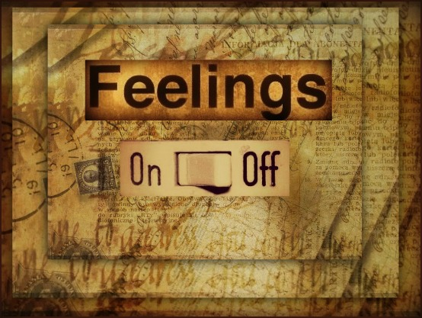

Slide 7
Notes:
In addition to their technical skills, therapists need to have personal psychological skills that they bring into their therapeutic relationship. The ACT model specifies those psych skills are acceptance, defusion, self-as-context, present moment, values, and committed action. All of these components combined make-up psychological flexibility.

Slide 8
Notes:
This pilot study assessed the developing skills of 10 graduate students who were trainees in clinical behavior analysis, who were preparing for first field placement. They participated in a four and a half day of ACT training. It involved lots of experiential training e.g., imagery, meditations, paired exercises, role play) e.g. stare at partner role playing as a client, cannot move body, only show listening thru eyes.

Slide 9
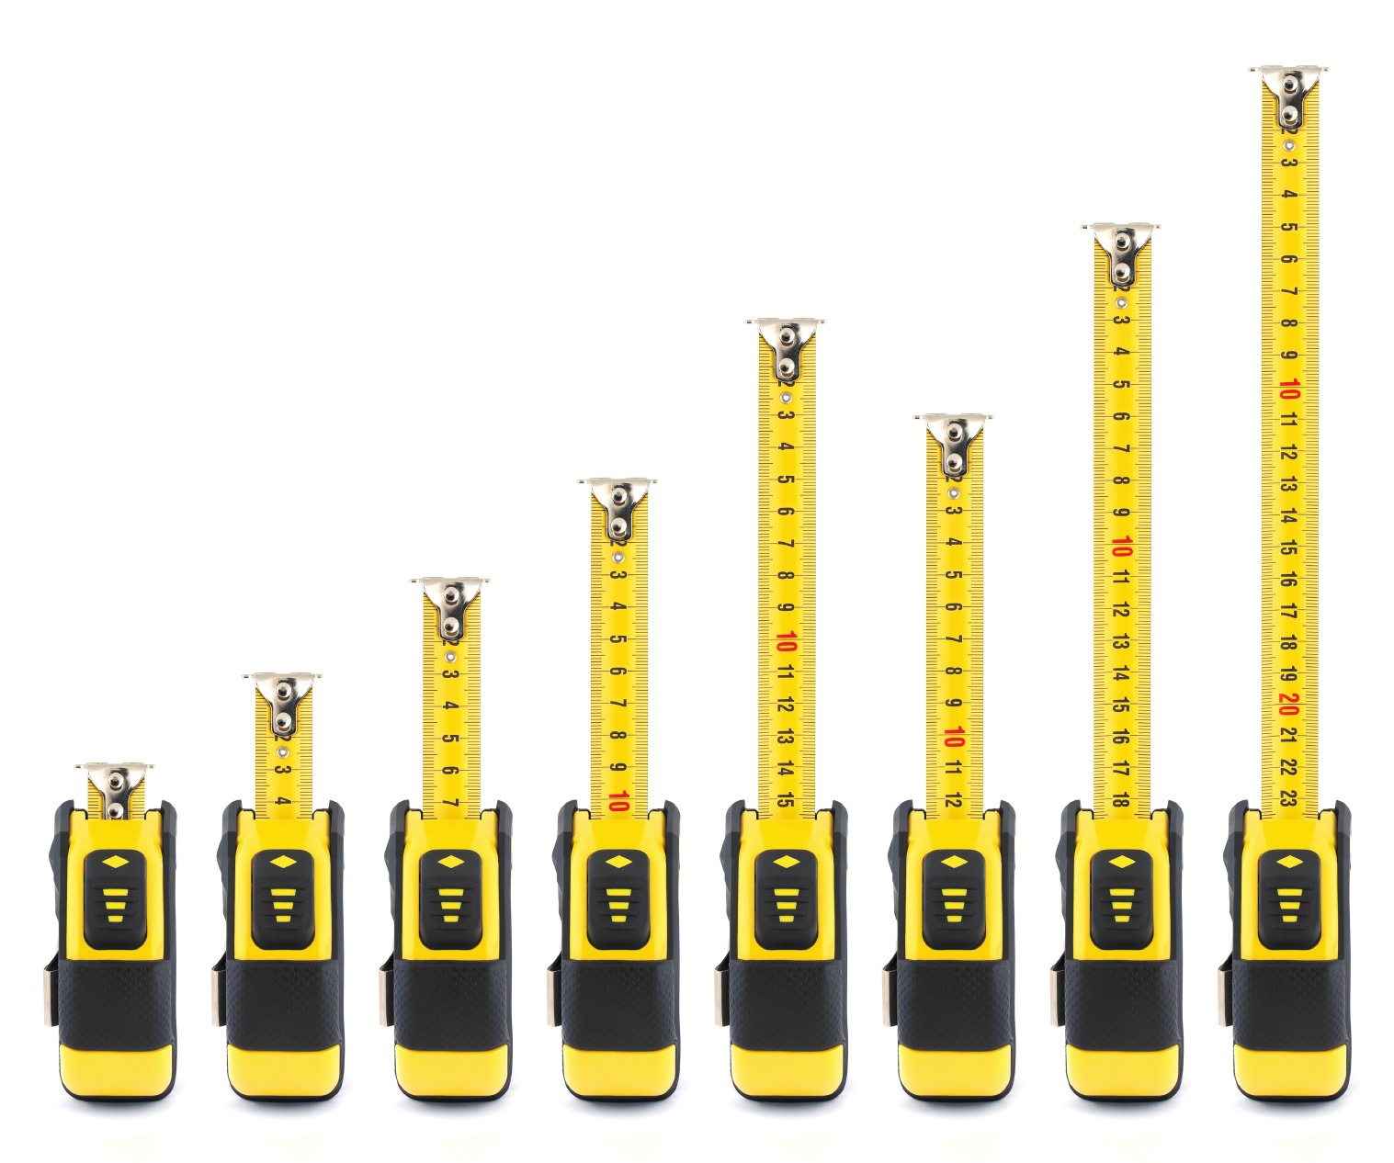
Measures
Therapist Belief Scale (TBS-R)
Interpersonal Reactivity Index (IRI)
Acceptance and Action Questionnaire (AAQ-II)
Notes:
Given these measures before training, after training, and follow-up.
Follow-up was approx 5-8 weeks after workshop and when students completed first practicum, where they actually saw clients, at the end of the semester.

Slide 10
Therapist
Scale
Notes:
Measures automatic thoughts that a therapist has about his/her work
29 questions with a 6-point likert scale ranging from strongly agree to strongly disagree
Original study found that: “Therapist beliefs were found to predict vulnerability to vicarious traumatization and burnout”

Slide 11
Tolerance of Distress
If I allow myself to feel what my client feels I’ll be damaged.
I must not allow my client to become too distressed in therapy.
I shouldn’t allow my clients to become distressed, they really want to feel better.
Notes:
1. Tolerance of distress
If therapist experiences high levels of distress about their abilities then will engage in experiential avoidance. The opposite of acceptance. Avoidant therapist may fail to explore certain client topics if they are tough or personally difficult material, or may change the topic when they emerge, or even fail to acknowledge their presence at all.

Slide 12
Rigid Model Adherence
If I just stick to one therapeutic model it will solve the problem for me.
Once I have decided on a treatment model I should stick to it.
Notes:
2. Rigid adherence to therapeutic model
If therapist to rigid, then by definition they are not able to be flexible and may engage in avoidant behaviors.

Slide 13
Belief of Responsibility
If my clients do not progress it is my responsibility.
I am responsible if therapy is not successful.
Notes:
3. Belief of responsibility
Feelings of responsibility for the outcome of the therapy
If therapist feels personally responsible then they are more likely to engage in avoidant behaviors as well.

Slide 14
Need for Control/Understanding
If I don’t have all the information I’m uncomfortable with therapy.
I must fully understand what happens in therapy in order to help the client
Notes:
4. Need for control and understanding
If therapist dominates session, then no time or space for the client.

Slide 15
Interpersonal Reactivity Index (IRI)
Notes:
28-items answered on a 5-point Likert scale ranging from “Does not describe me well” to “Describes me very well”
Few subscales, each measuring different therapist skills.

Slide 16
Perspective Taking (PT)
“When I am upset at someone, I usually try to ‘put myself in his shoes’ for a while.”
Notes:
1. Perspective taking
Items of the IRIptscale address one's tendency to take another's point-of-view, akin to the “theory of mind” (e.g. “When I am upset at someone, I usually try to ‘put myself in his shoes’ for a while.”). Th

Slide 17
Empathic Concern (EC)
“When I see someone being taken advantage of, I feel kind of protective towards them.”
Notes:
2. Empathic concern
measures sympathy and concern for others.
Defines empathy as the “reactions of one individual to the observed experiences of another (Davis, 1983)”
The EC subscale measures other-oriented feelings of sympathy and concern for others in distress. IRIec items relate to feelings of empathy towards others (e.g. “When I see someone being taken advantage of, I feel kind of protective towards them.”).

Slide 18
Personal Distress (PD)
“In emergency situations, I feel apprehensive and ill-at-ease.”
Notes:
3. Personal Distress
measures the kind of feelings (anxiety, etc.) that gets in the way of helping others.
IRIpd addresses the tendency to experience distress in stressful situations (e.g. “In emergency situations, I feel apprehensive and ill-at-ease.”). The PD subscale assesses self-oriented anxiety when experiencing others in distress.

Slide 19
Acceptance and Action Questionnaire (AAQ-II)
Notes:
The last measure we used was the AAQ-2. This scale measures the therapist’s psychological inflexibility.
When inflexible, focus more on aversive stimuli than the appetitive stimuli that arises in a the therapy context. If therapist becomes inflexible, reacting towards the aversive stimuli that comes up in sessions, then impede the work that needs to get done

Slide 20
p = .06
7/8
Higher scores = higher tolerance of distress
Notes:
p=0605
p=0.0791 diff between pre and post almost sign
Higher scores = higher tolerance of distress

Slide 21
Higher scores = less rigidity
P = .68
6/8
Notes:
Higher scores = less rigidity
NS

Slide 22
Higher scores = felt less responsibility
Notes:
p=.1311
p=0.0380 Between pre and post
Higher scores = felt less responsibility

Slide 23
Higher scores = less need for control
p = .31
5/8
Notes:
p=0.3190
Higher scores = less need for control

Slide 24
Higher score = greater PT
p = .032*
6/8
Notes:
p=0.0329 Significant
Pre to Post almost sig. .068
Higher score=greater PT

Slide 25
Higher Scores = More Personal Distress
p = .28
5/8

Slide 26
Higher scores = more empathic concern
p = .02*
5/8
Notes:
p=0.0244 (all sign diff)
p=0.0011 (Pre and post very sign)
Measures emotional feelings of empathy... So could get in the way of therapy session. Much be able to maintain a context in which the client has space for their responses, therapists part to guide them. Important because PT increased significantly, while EC decreased significantly.

Slide 27
Higher Scores = Higher Inflexibility
p = .56
6/8
Notes:
NS

Slide 28
Notes:
So, What does this mean?
With this small of a sample size, it was interesting to find the PT increased and EC decreased significantly. While the other pieces involved in the development of these behavior analysts all had interesting trends, some approaching significance. Therefore, it would be interesting to see how these trends would hold up with a larger sample.
The experiential training workshop does seem to affect PT and EC, therefore experiential training does play an important role in the education and development of therapists.

Slide 29
Thank You for Attending Today’s Presentation
emmy.lebleu@gmail.com
emilykenninson@gmail.com
www.louisianacontextualscience.com
Notes:
This is an ending page that includes a “Thank You” message, as well as room for any contact information.

